Slide 1
Analysis of 200Hz Cycling Data for Nova Hinges
By Ganesh Swaminathan

Slide 2
Objectives
Understand the influence of multiple factors on the Run Time of Counter-Weight (CW) and Optics Module (OM) hinges while cycling.
Utilize the Excel sheet “200Hz_Cycling_Data_06242024” raw test data to generate a tabular numerical dataset for analysis by defining failure (Hinge breakage) and success criterion for Run-Time (300+ hours)
Identify unique hinge configurations, perform machine learning to get feature importance measures and success rates.
Determine top 5 OM, CW hinge configurations & predicted Run times until failure supported by statistical measures

Slide 3
Code Implementation - 1
Access the test data and read it as a Pandas Data frame.
Define numerical codes for Type, Kapton location, Washer material and occurrence of failure for transformation of raw data into numerical values for analysis.
Group this modified numerical data by unique configurations and aggregate features . The obtained data contains a single data-point for a unique hinge configuration with maximum Run-time until failure/still cycling mode.
Begin Machine learning by defining features as all columns except Run Time, which is the output Label/Target.
The features are further classified as categorical and numeric features (which consists of Amplitude, frequency, Torque and Hinge build [T0/T1/T2/T3/T4] with values )

Slide 4
Code Implementation - 2
6. Perform preprocessing on the Pipeline by using sklearn preprocessing functions and use RandomForestRegressor.
7. Train the model and find the predicted run time until failure for each unique configuration. Bootstrap resampling to estimate sampling distribution for determining coefficient of variation (CoV)
8. Obtain the feature importance values from the pipeline & display it in a graphical format (bar-plots) to get insights on each specific feature importance with success % ( proportion of configurations having this feature with Run Time > 300 hours) measures.
9. Display the top 5 CW & OM hinge configurations based on highest Run-Time.
10. The predicted run time values until failure with Coefficient variation values are listed in a tabular format for further insights.

Slide 5
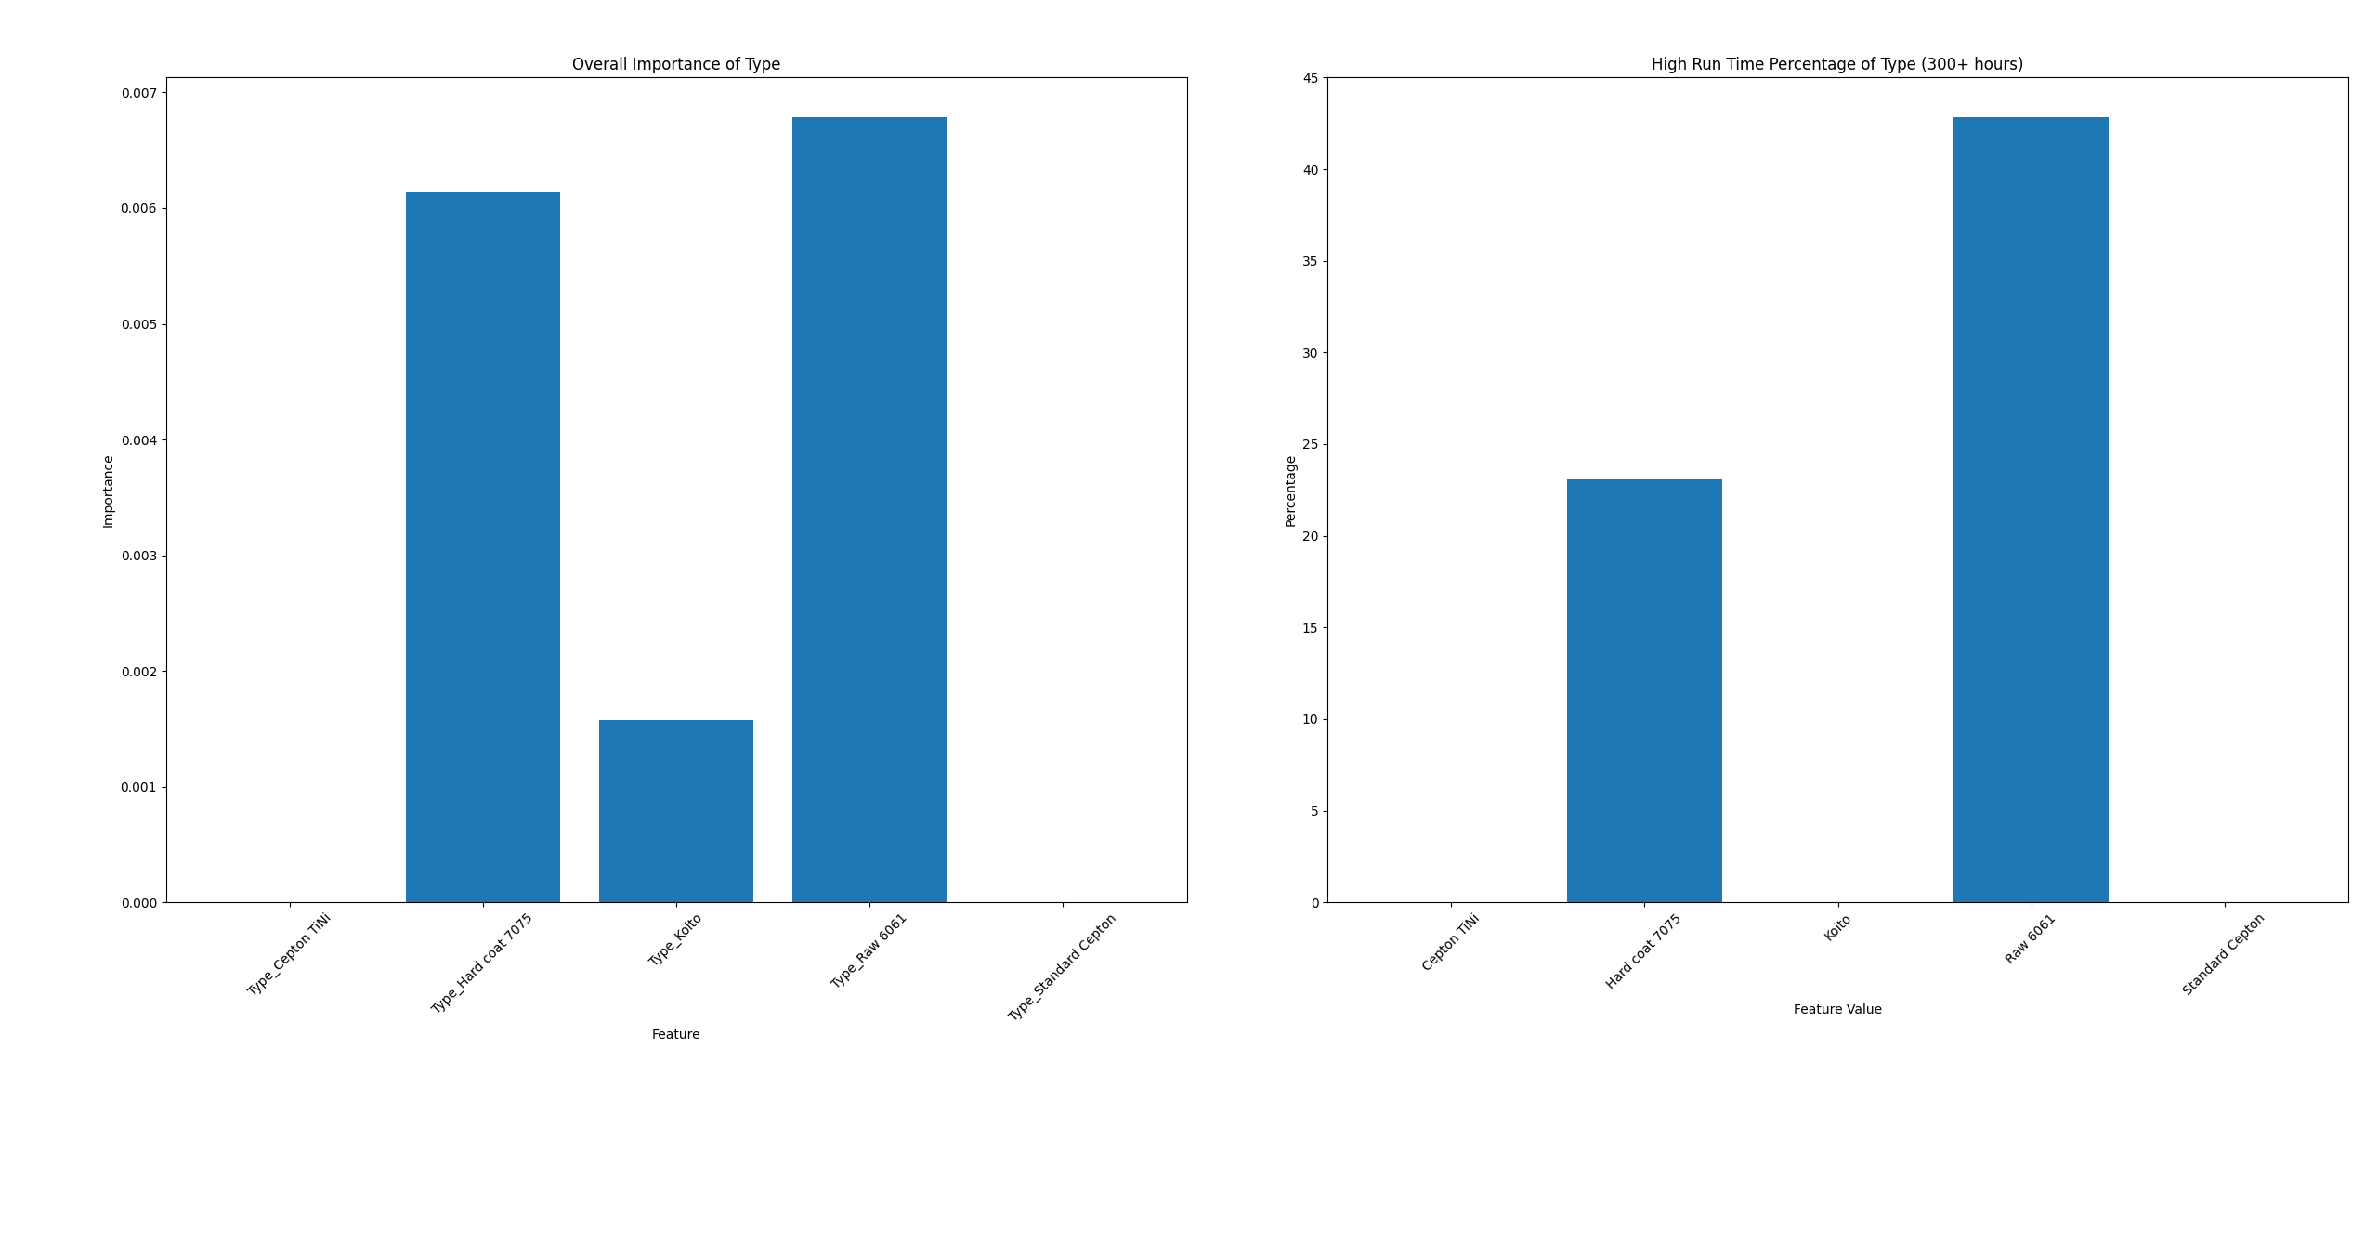
Results for OM Hinge

Slide 6
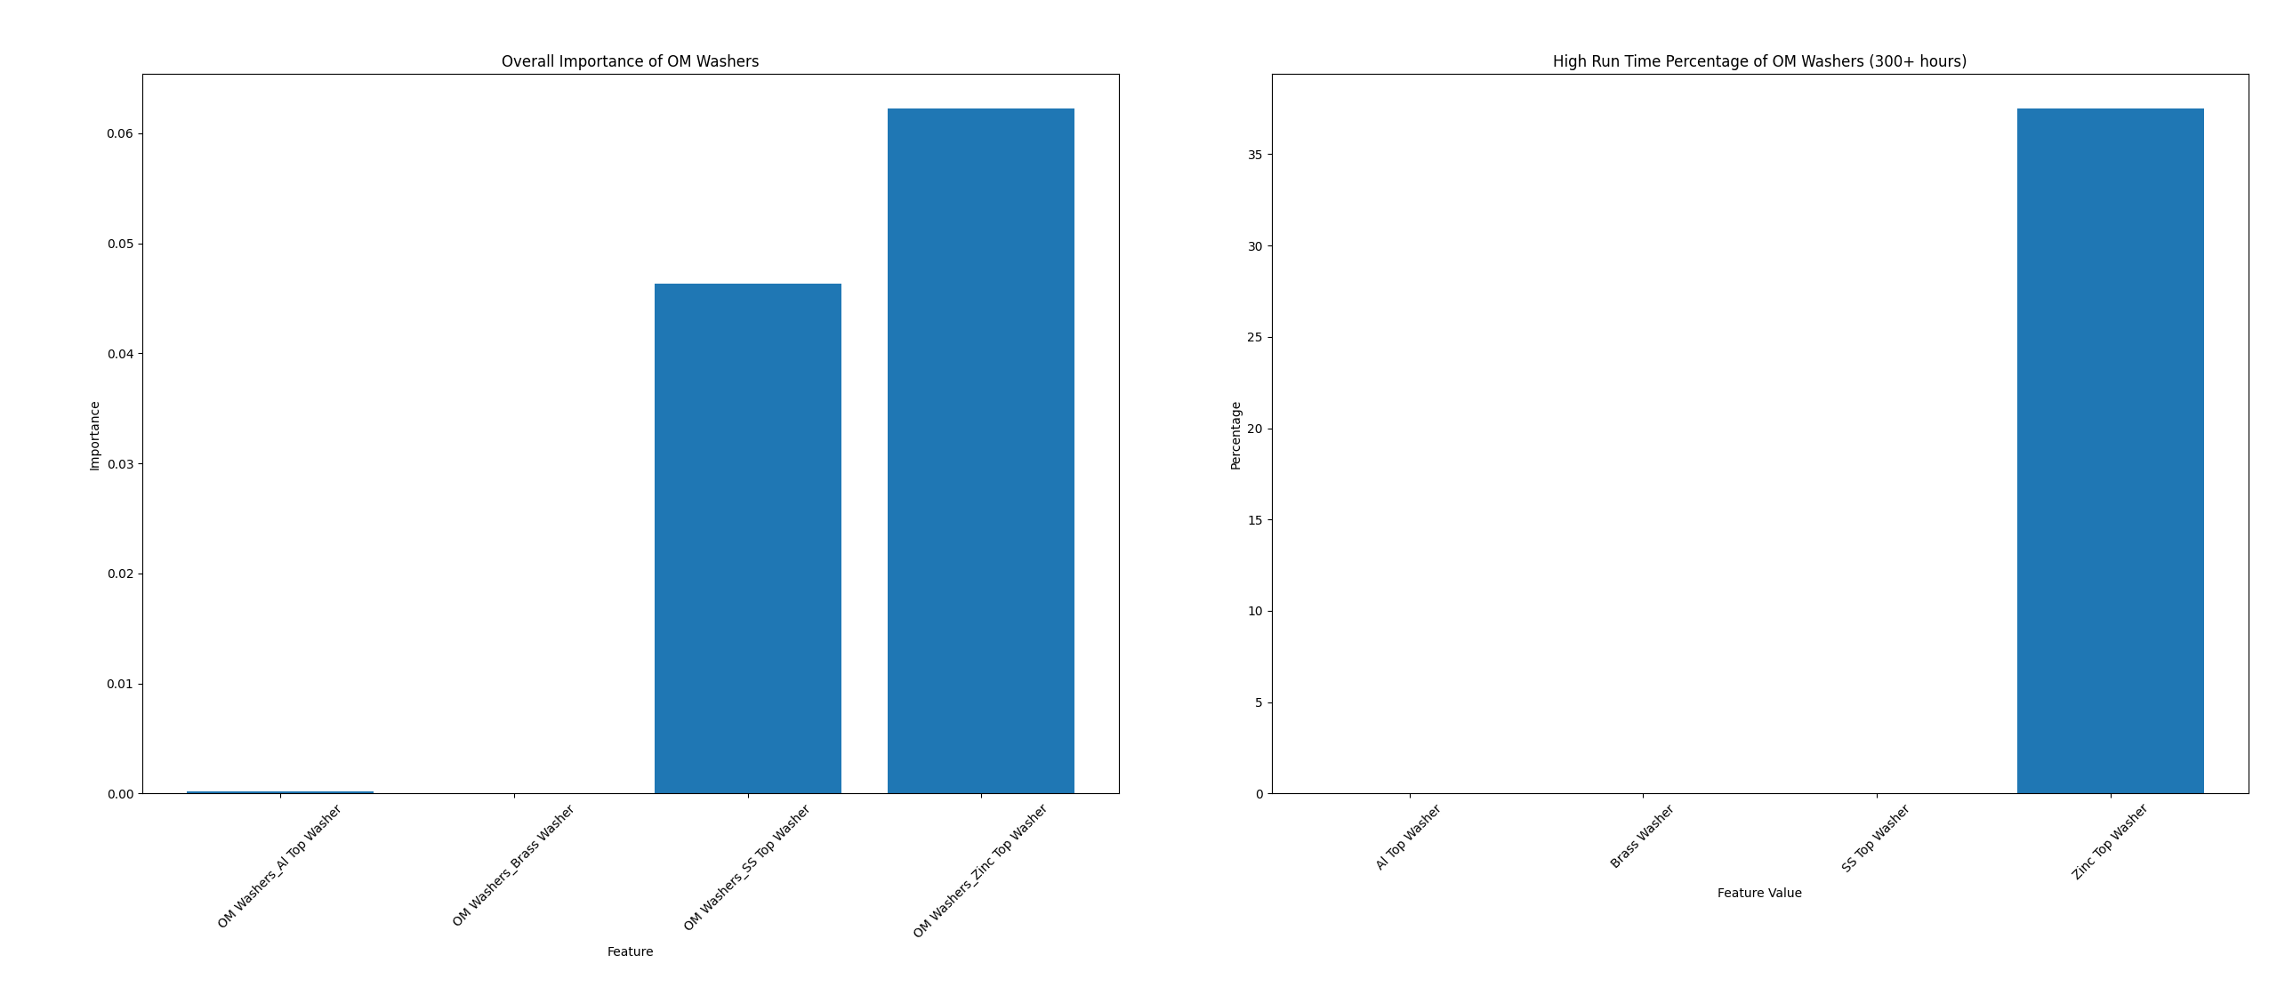
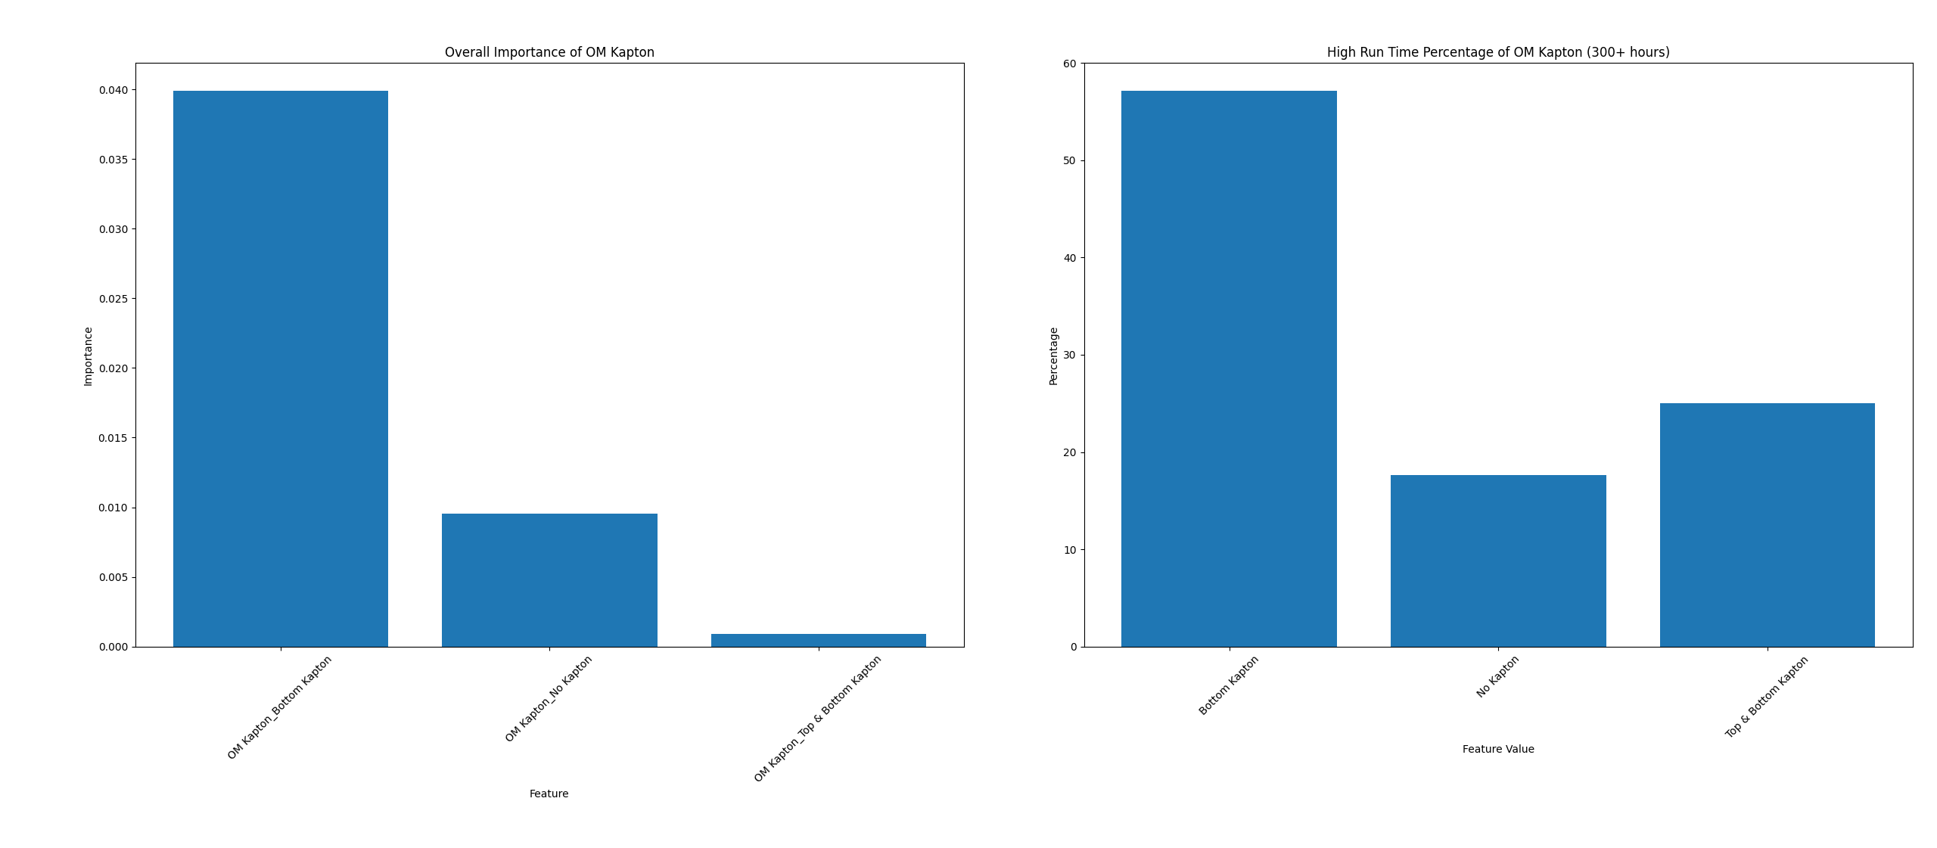
Results for OM Hinge

Slide 7
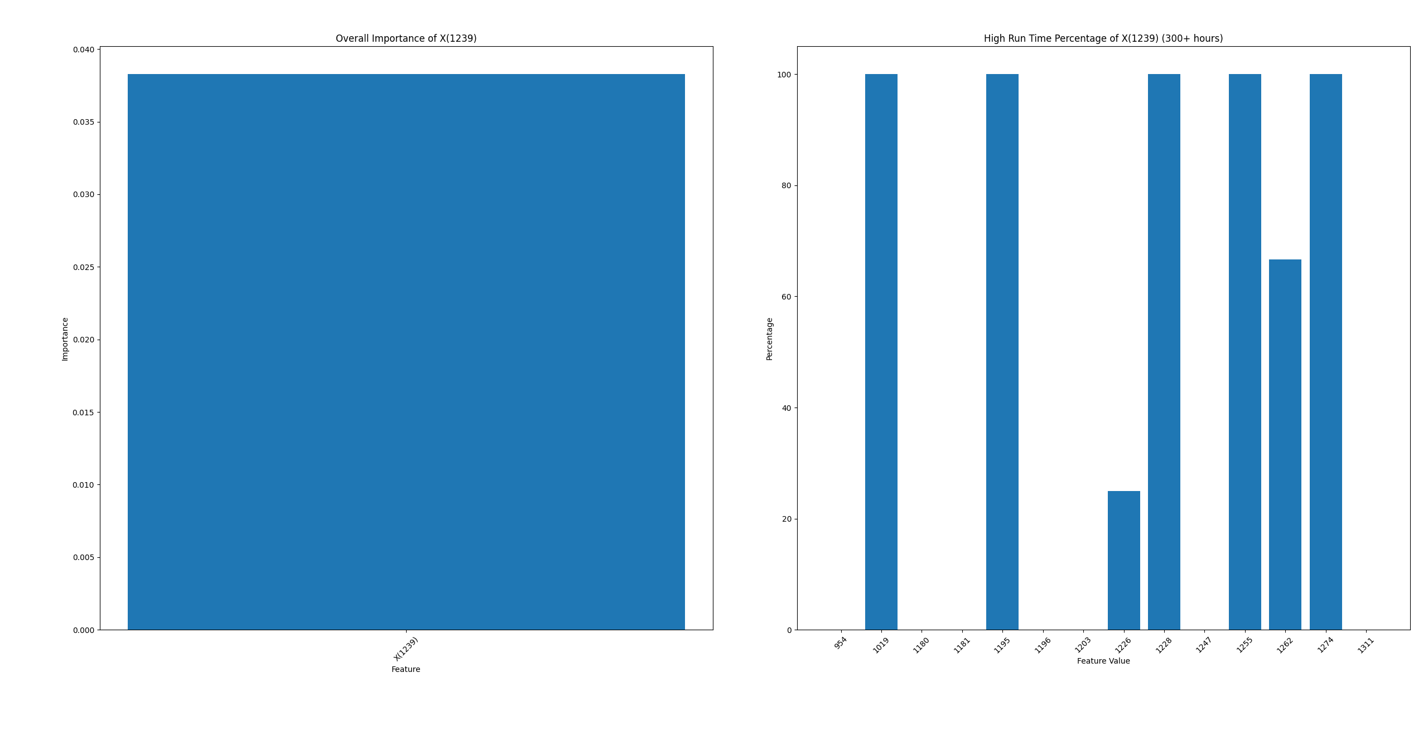
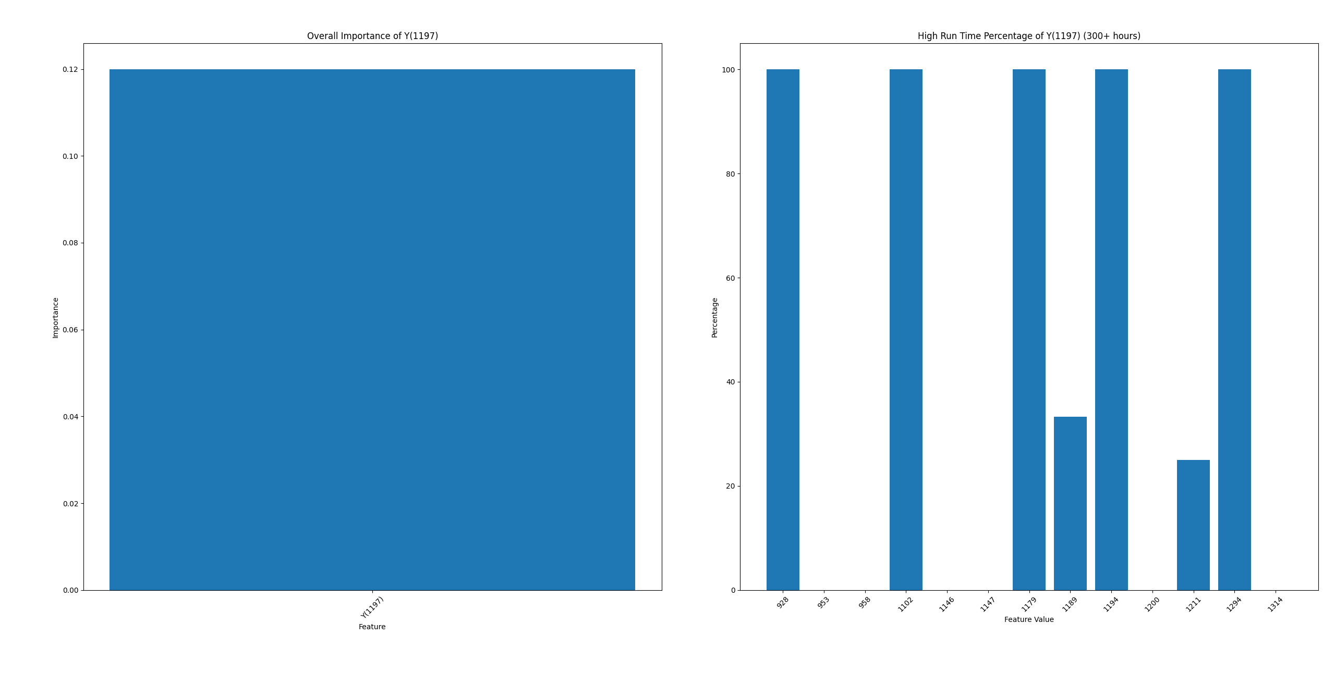
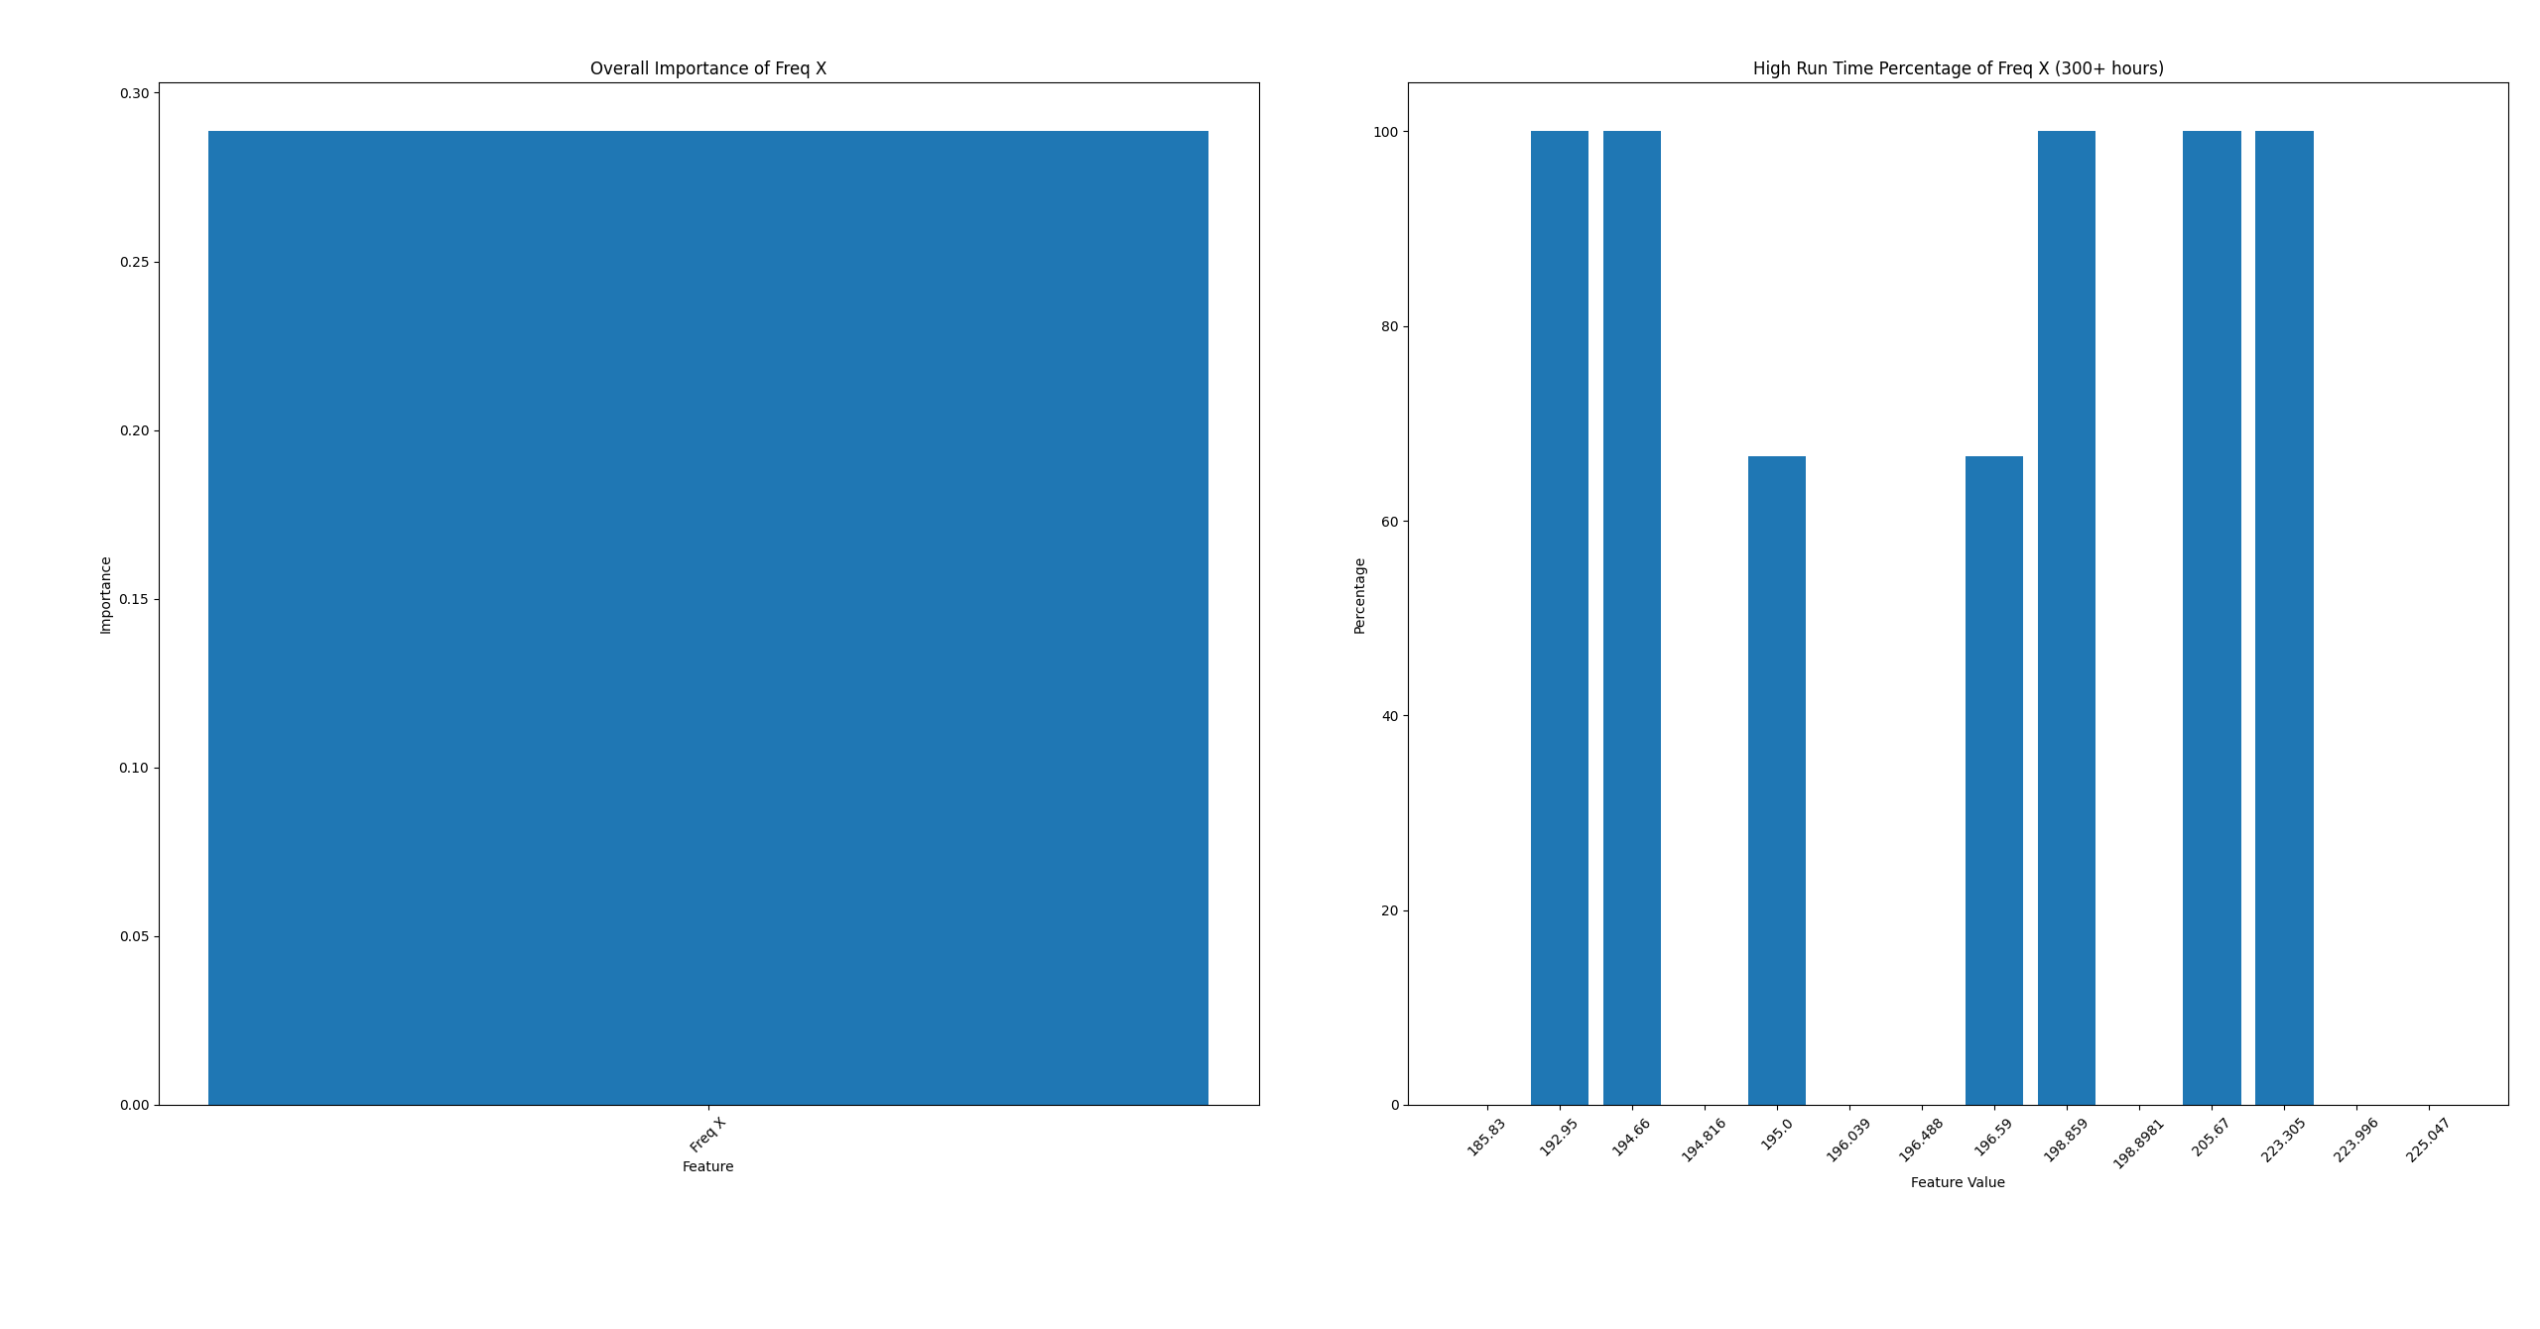
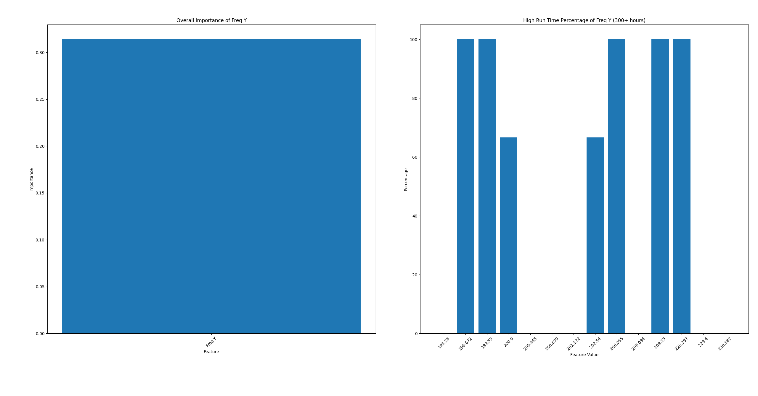
Results for OM Hinge

Slide 8
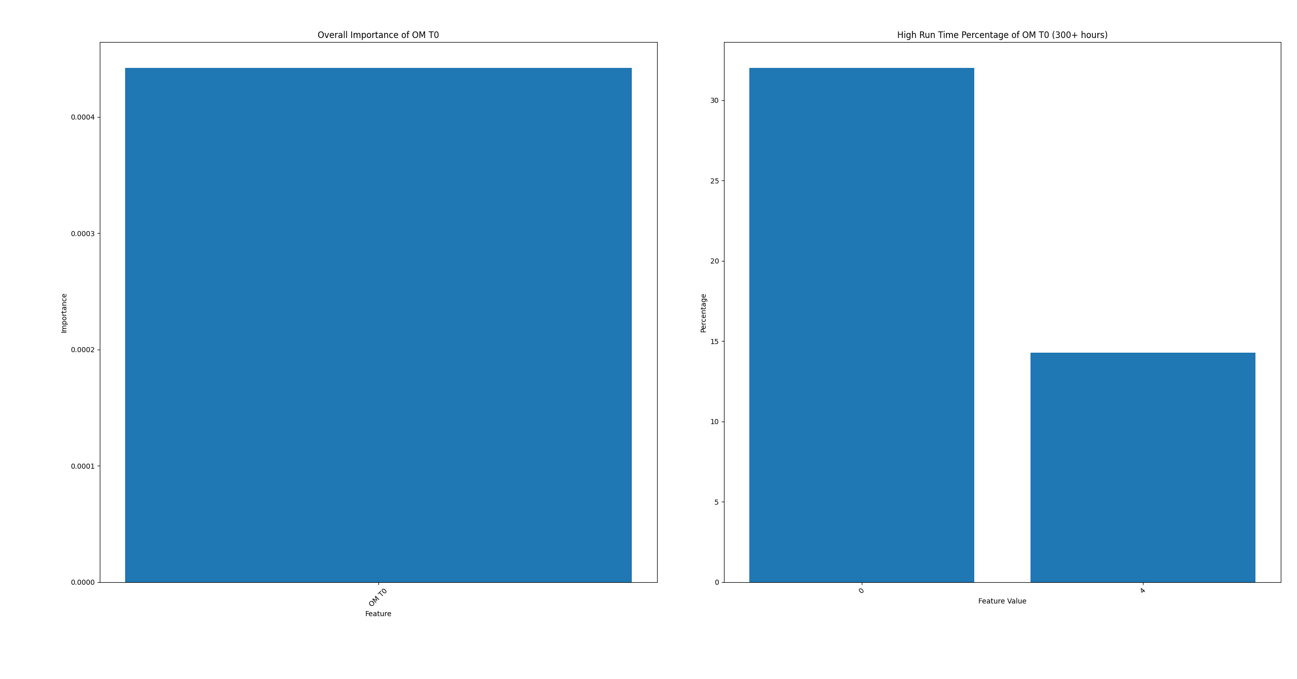
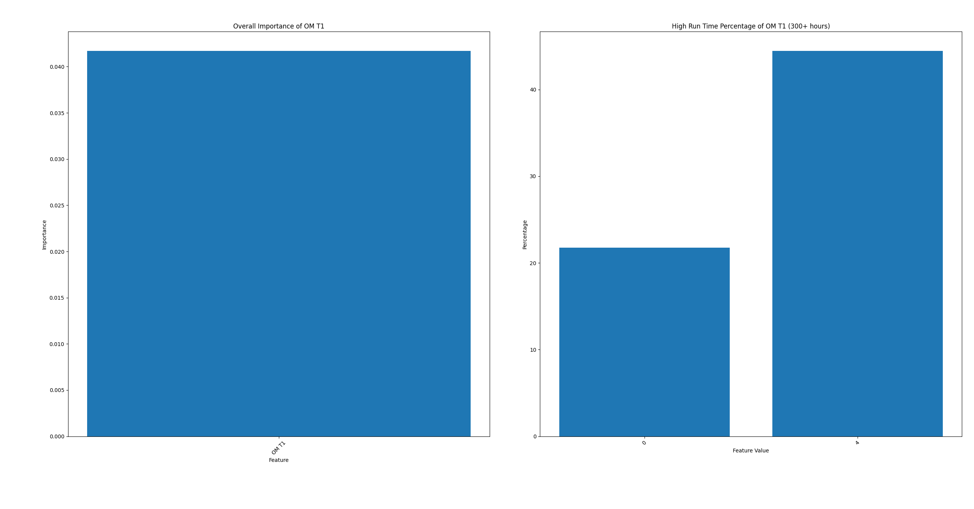
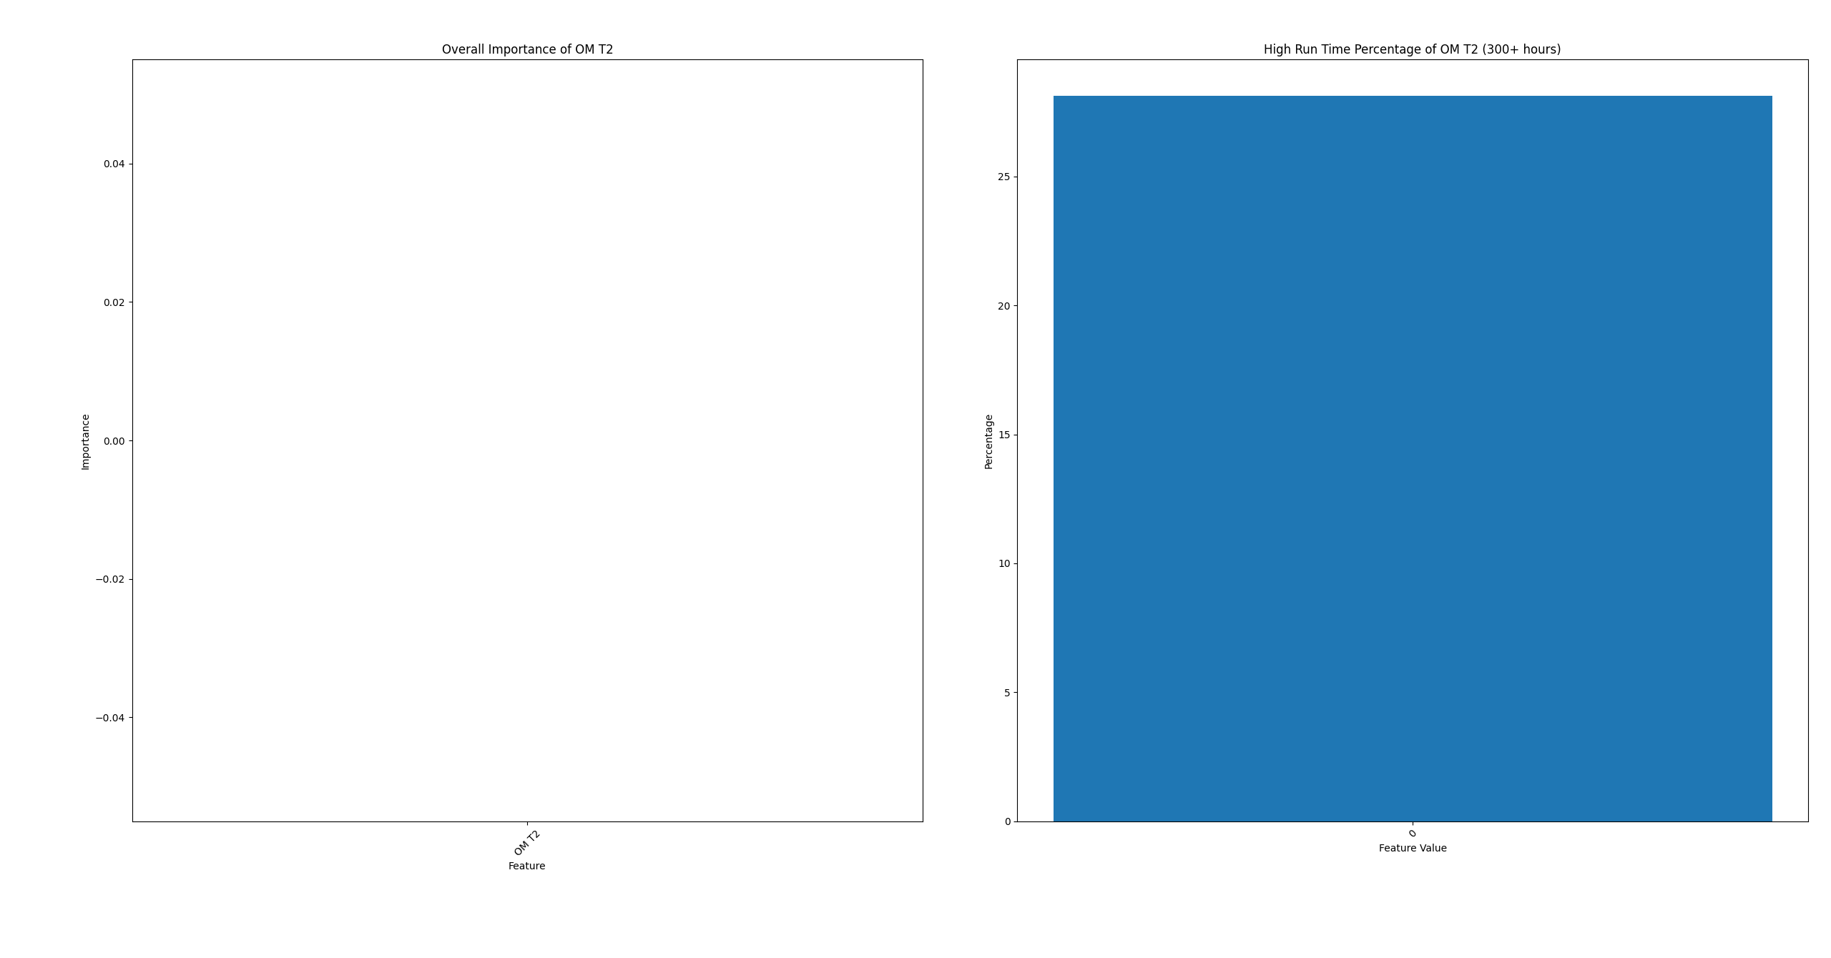
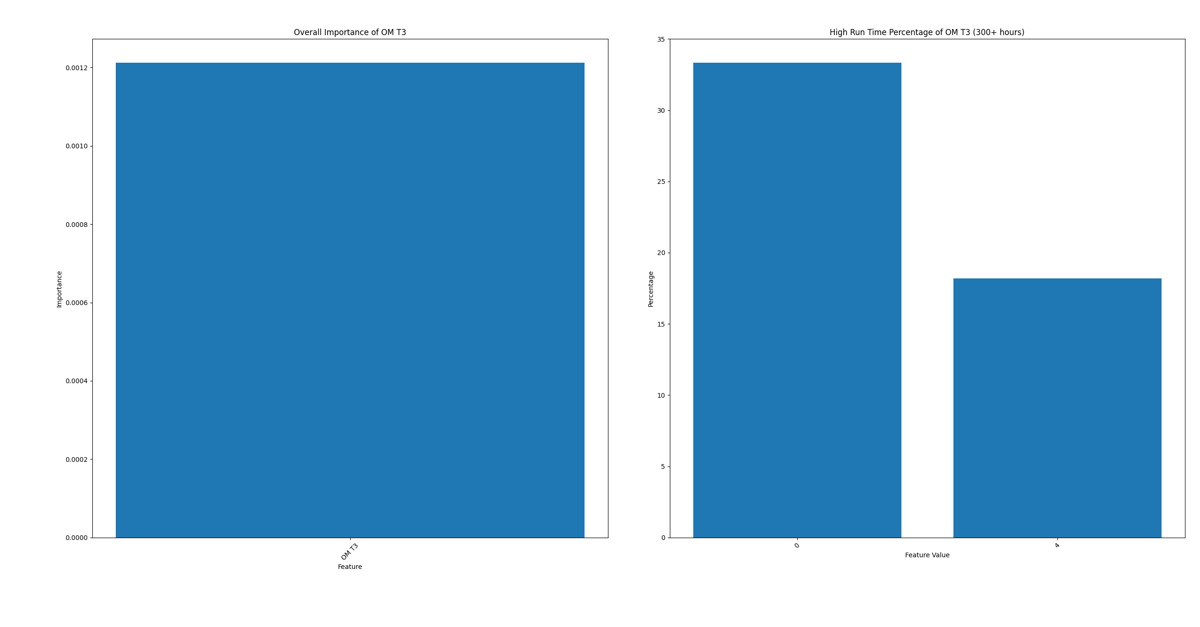
Results for OM Hinge

Slide 9
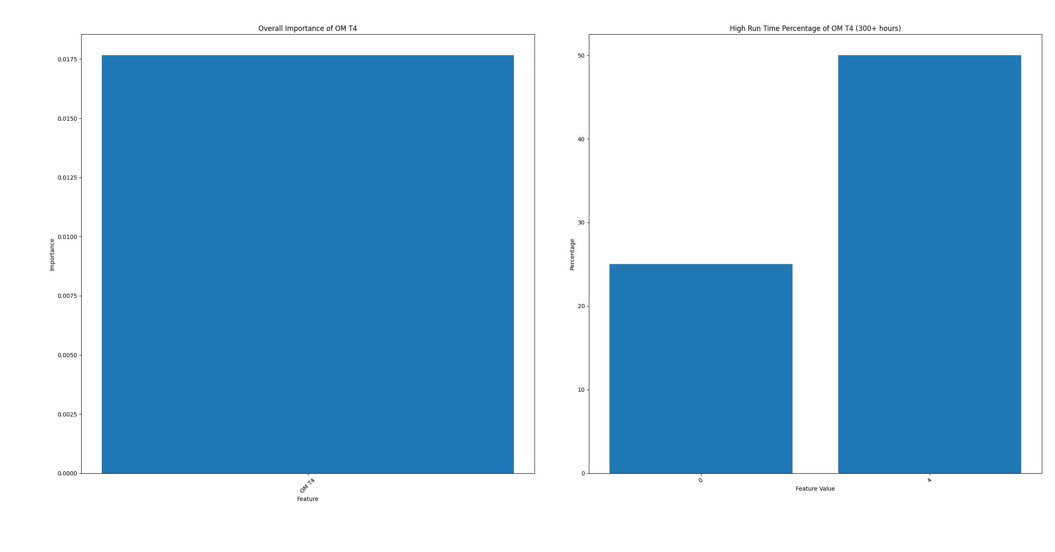
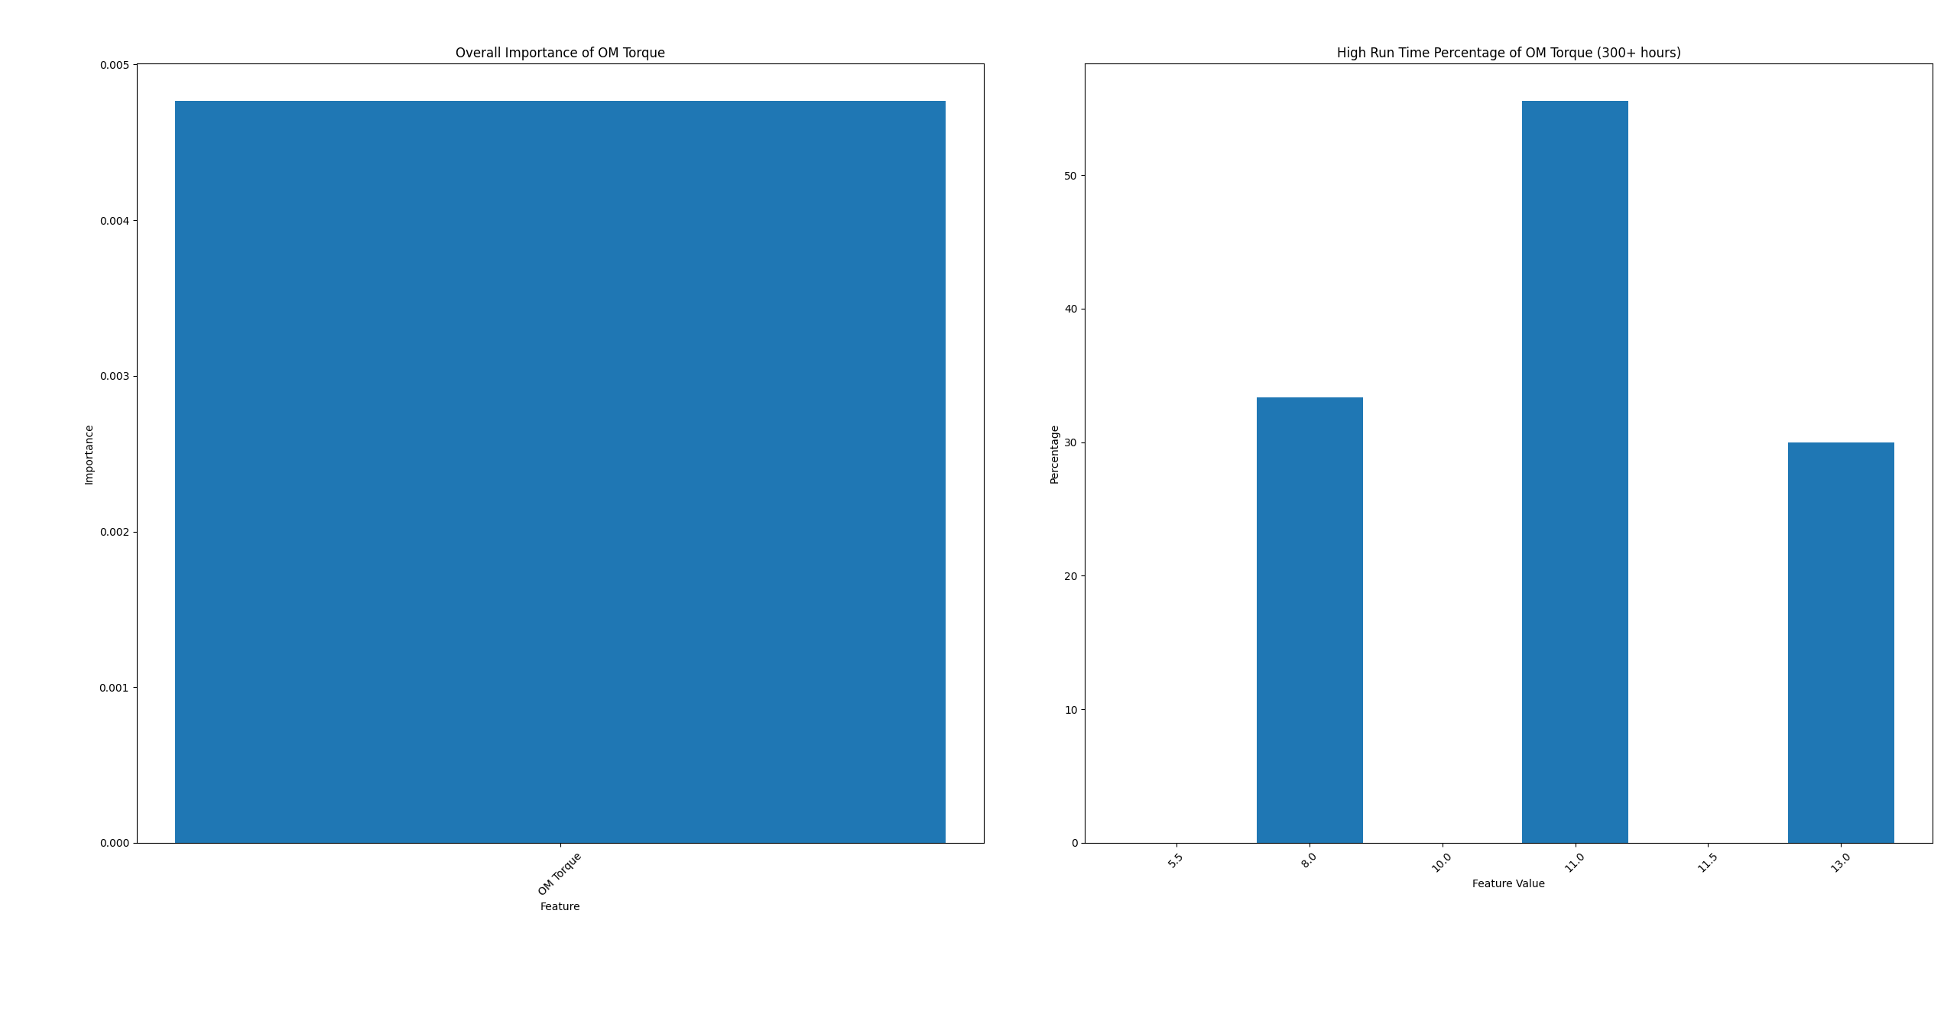
Results for OM Hinge

Slide 10
Results for OM Hinge

Slide 11
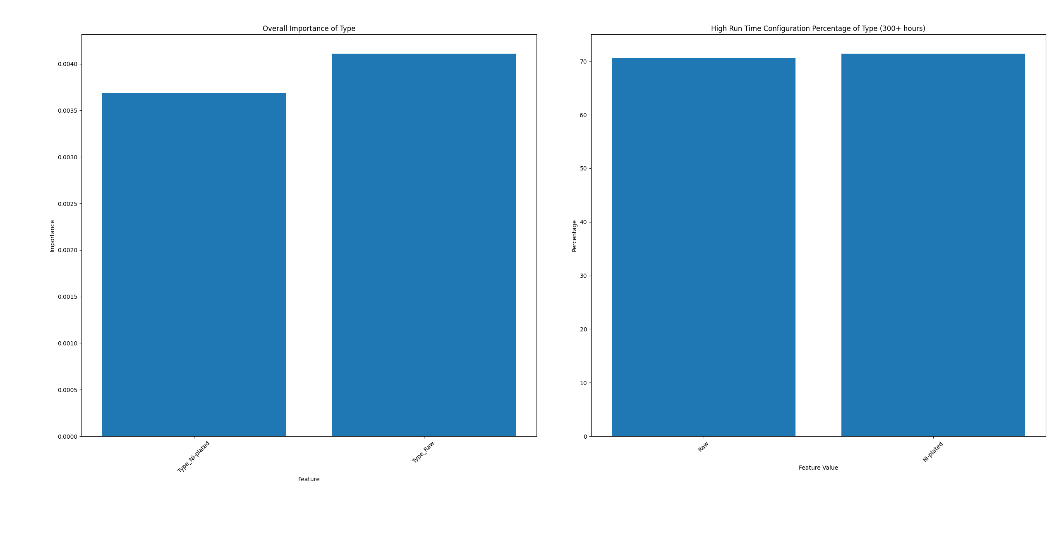
Results for CW Hinge

Slide 12
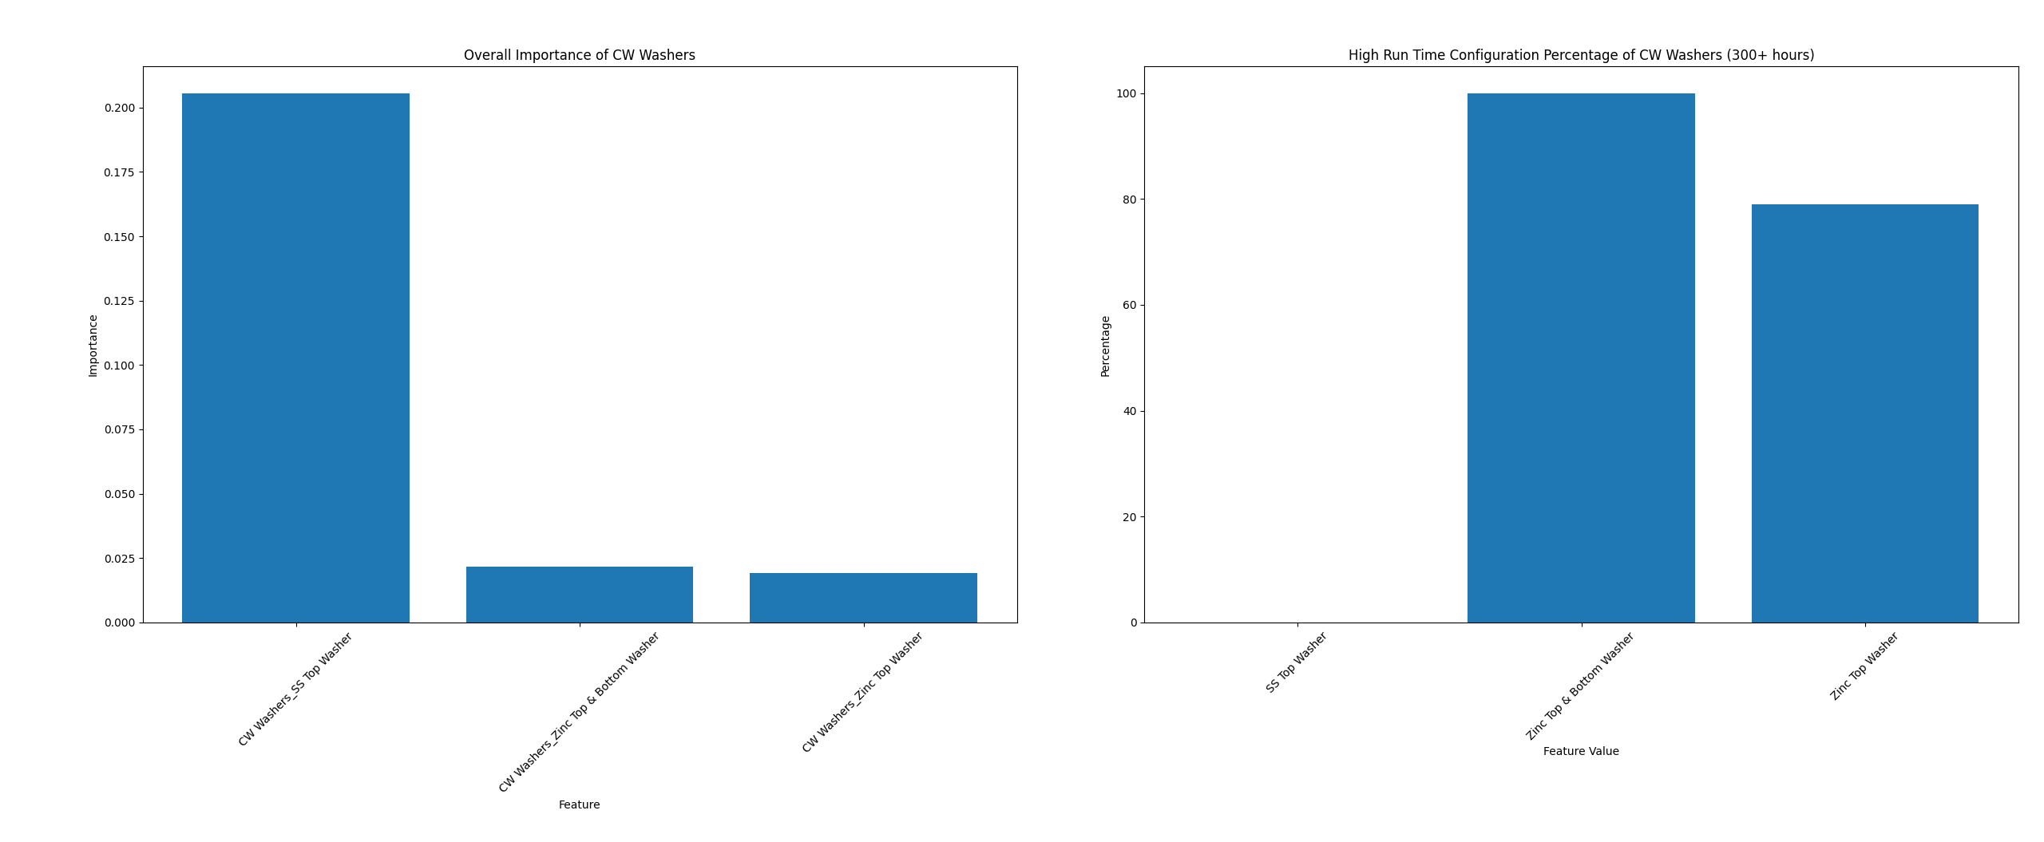
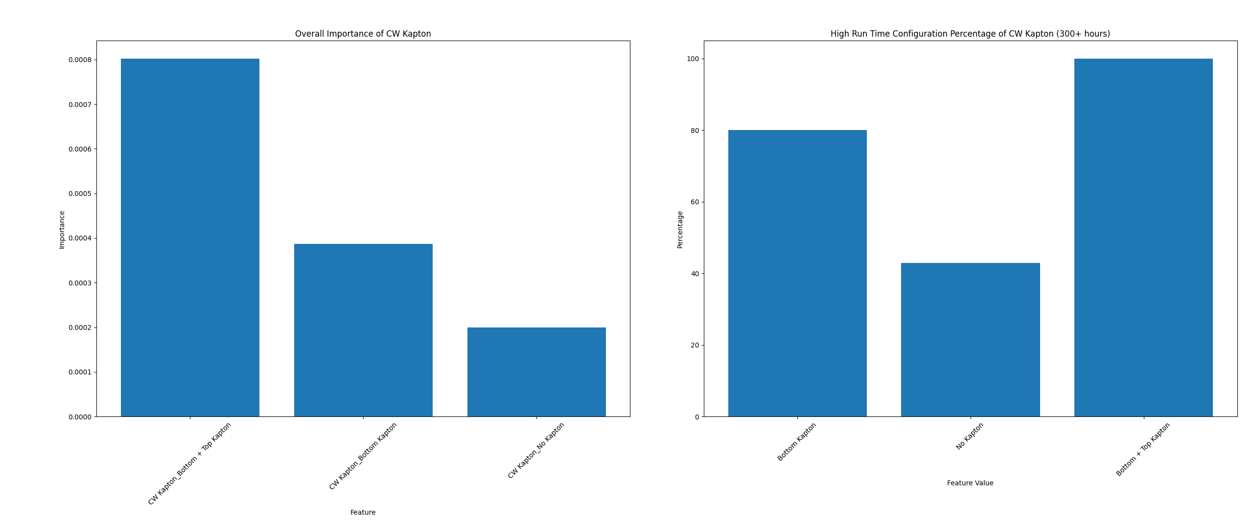
Results for CW Hinge

Slide 13
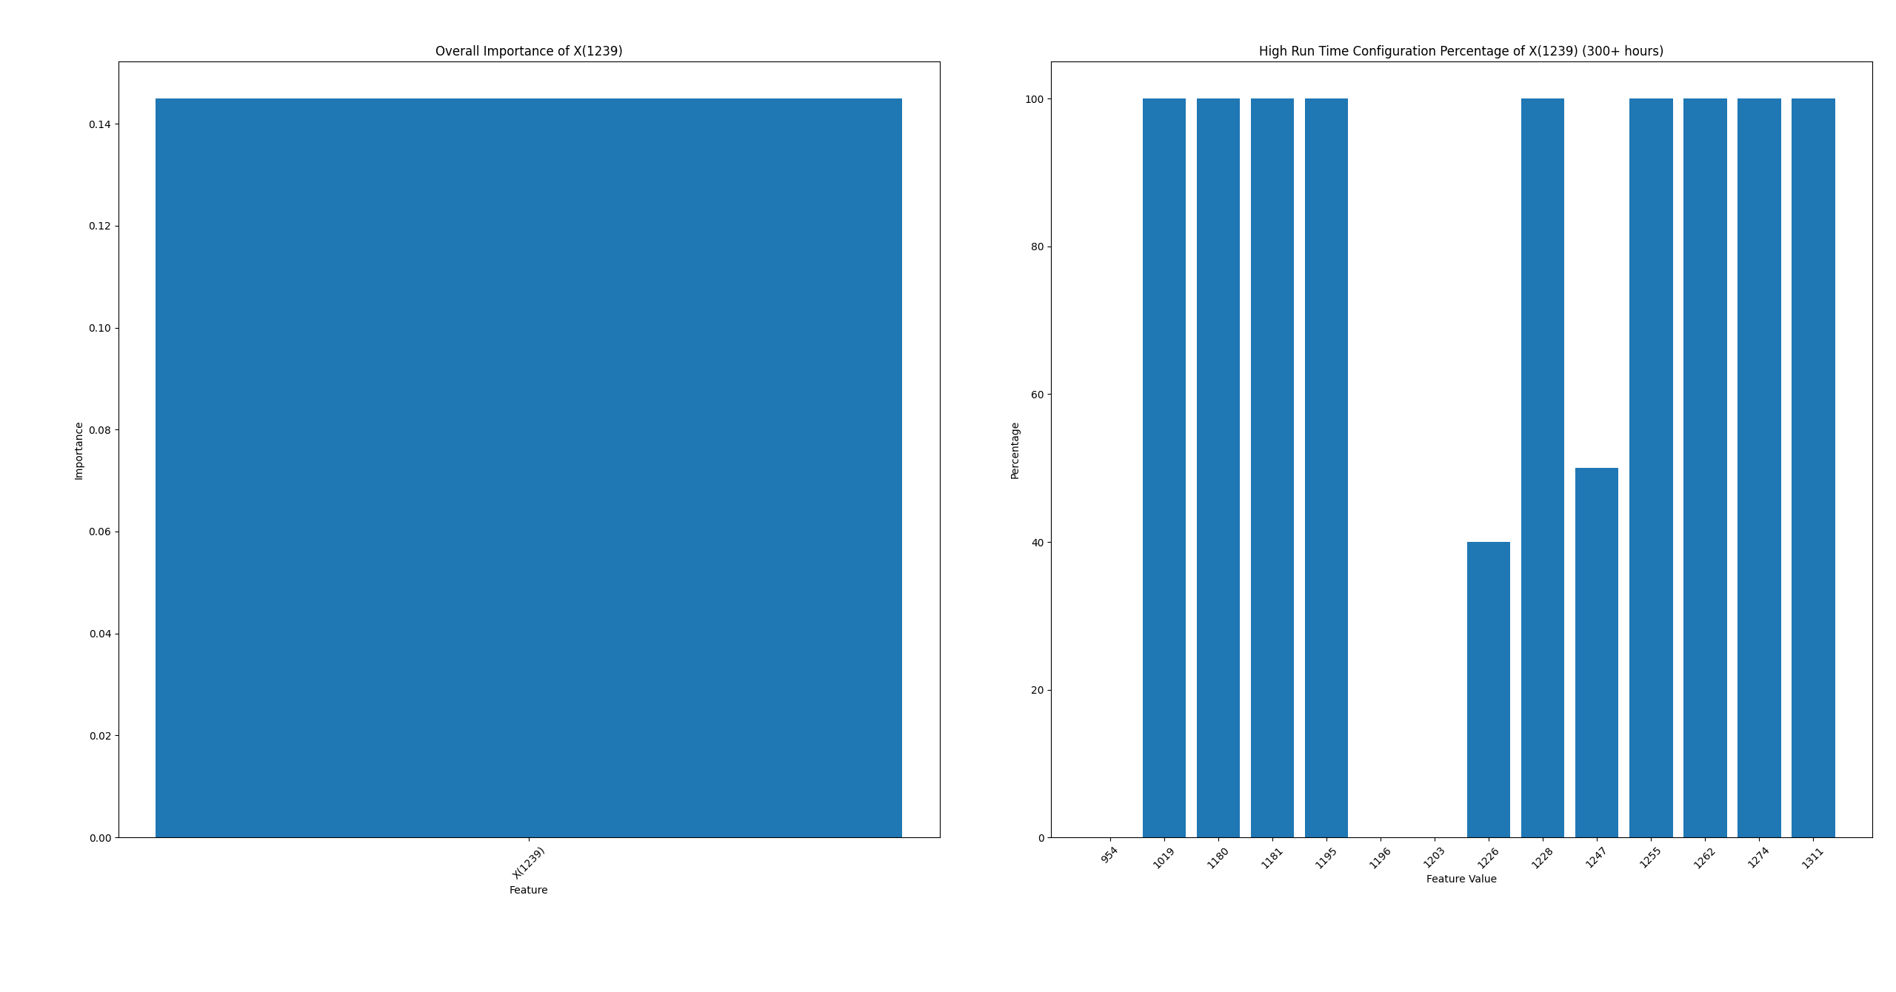
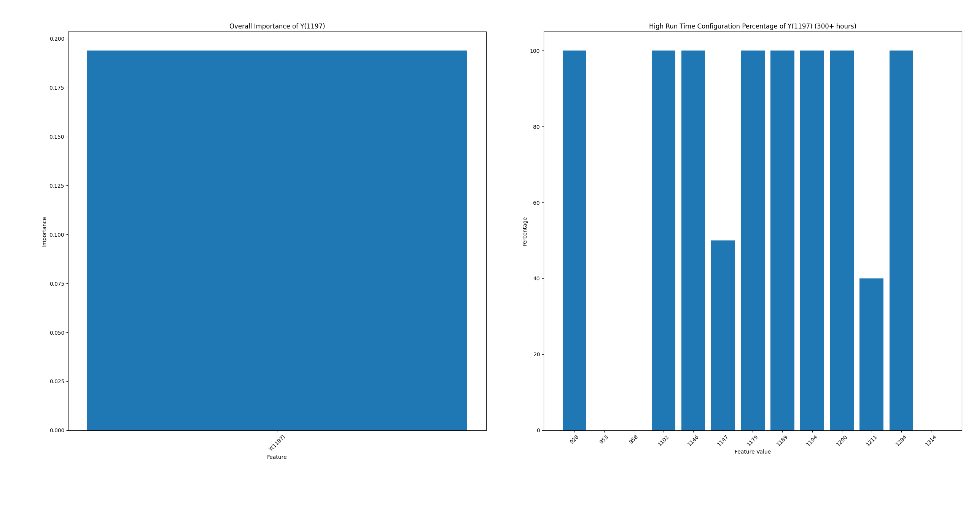
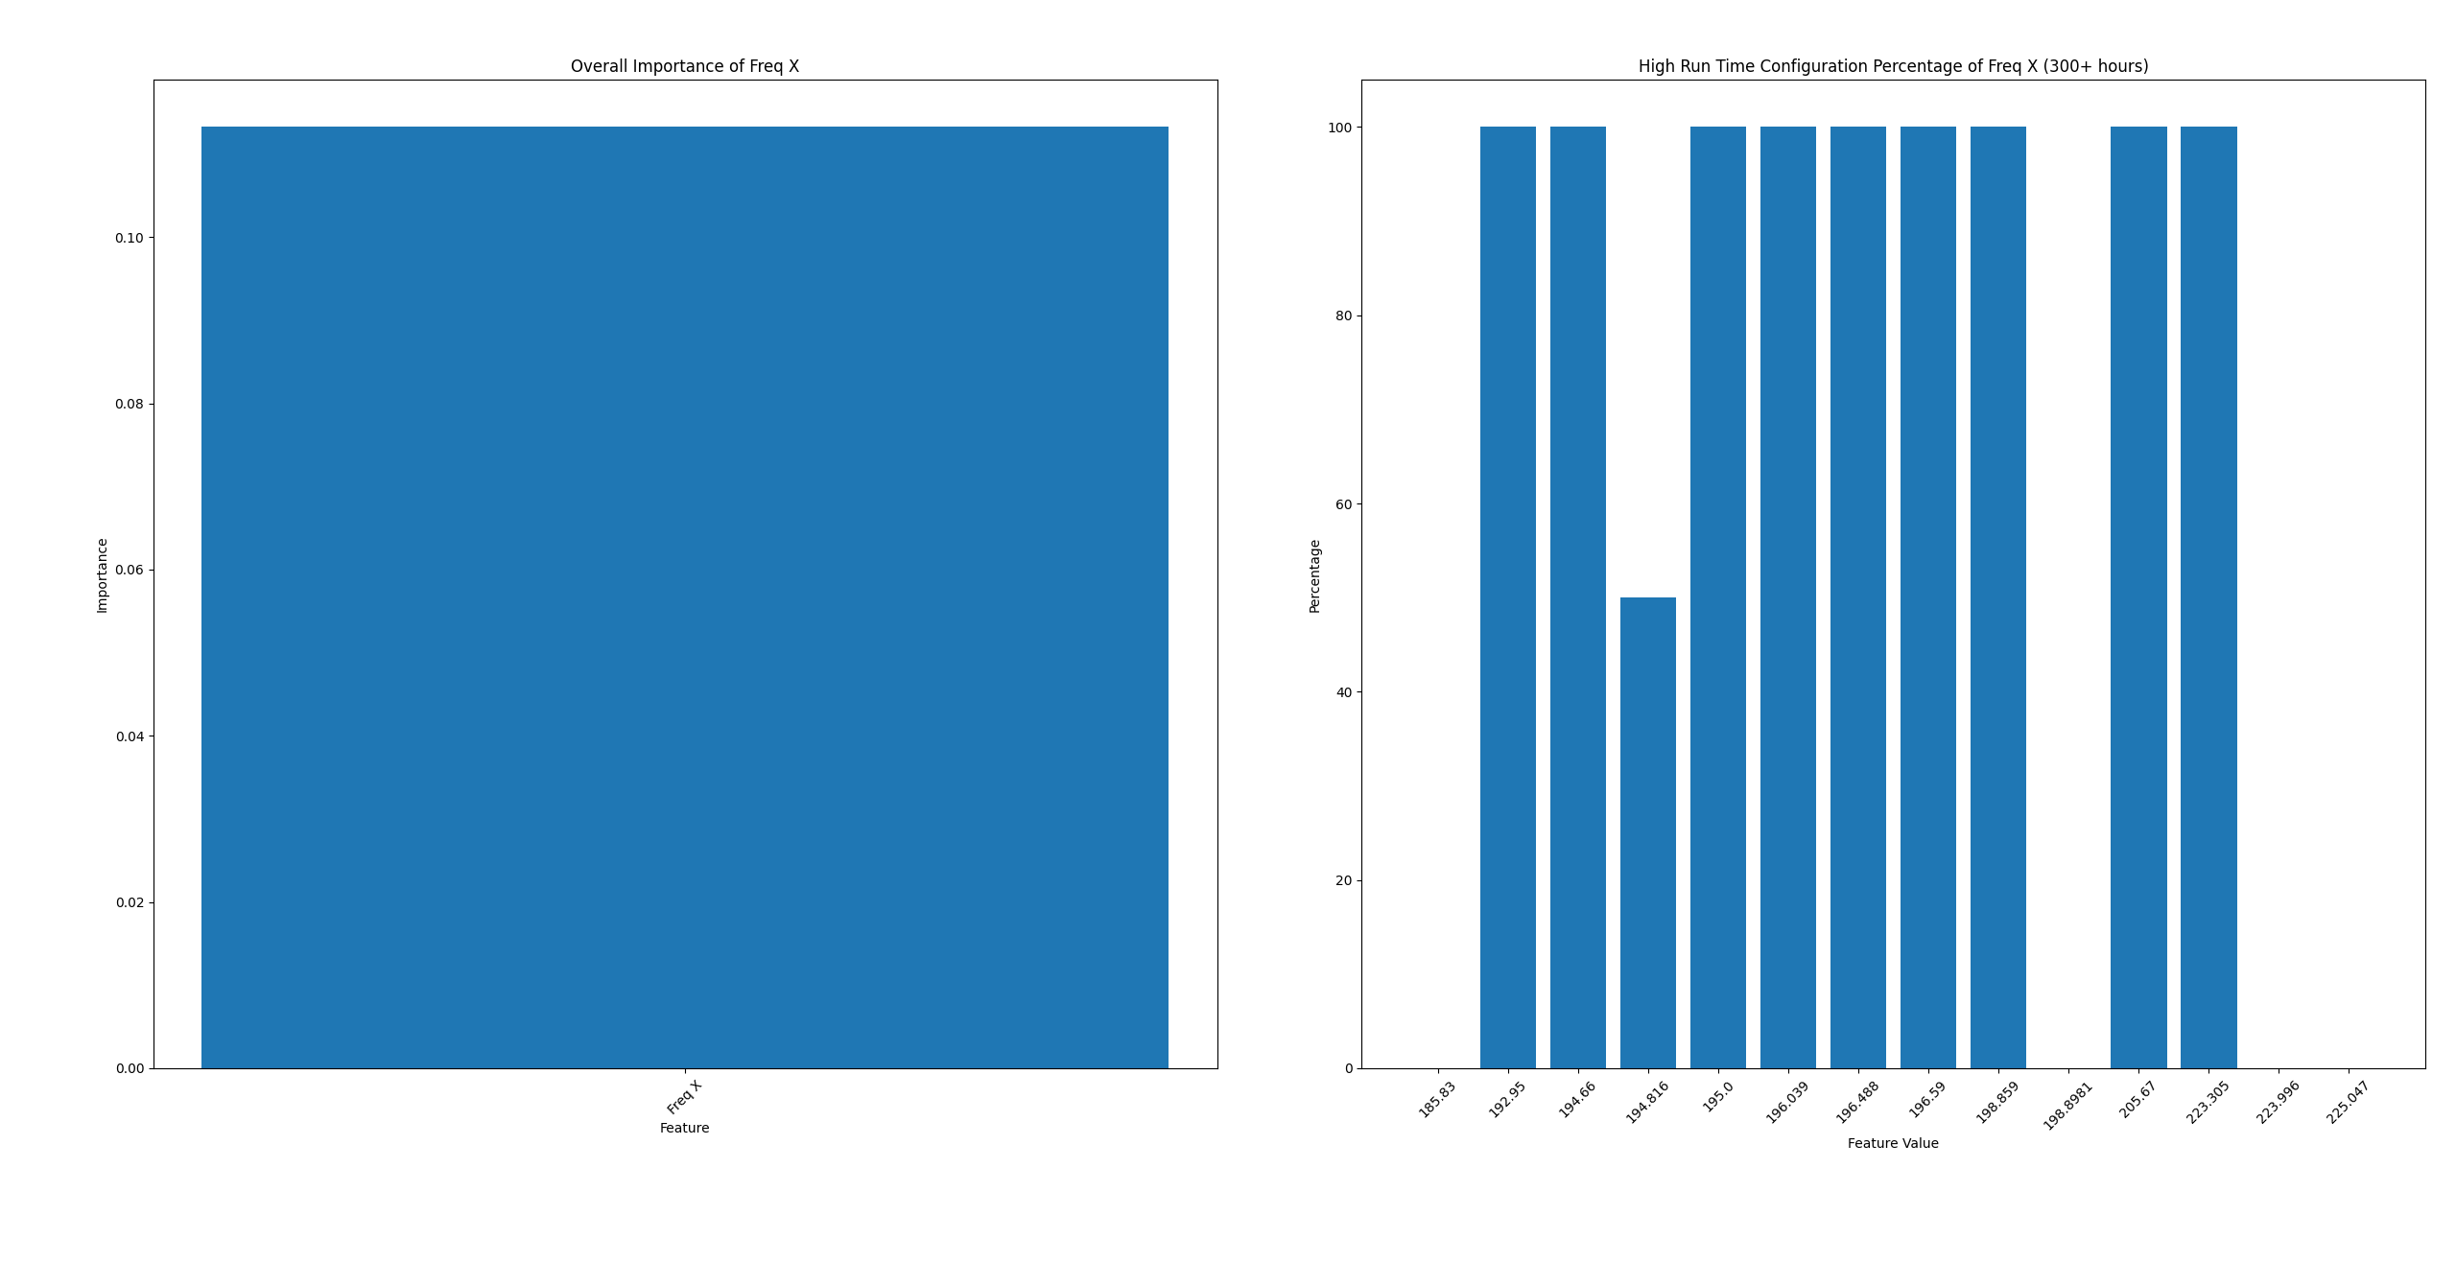

Results for CW Hinge

Slide 14

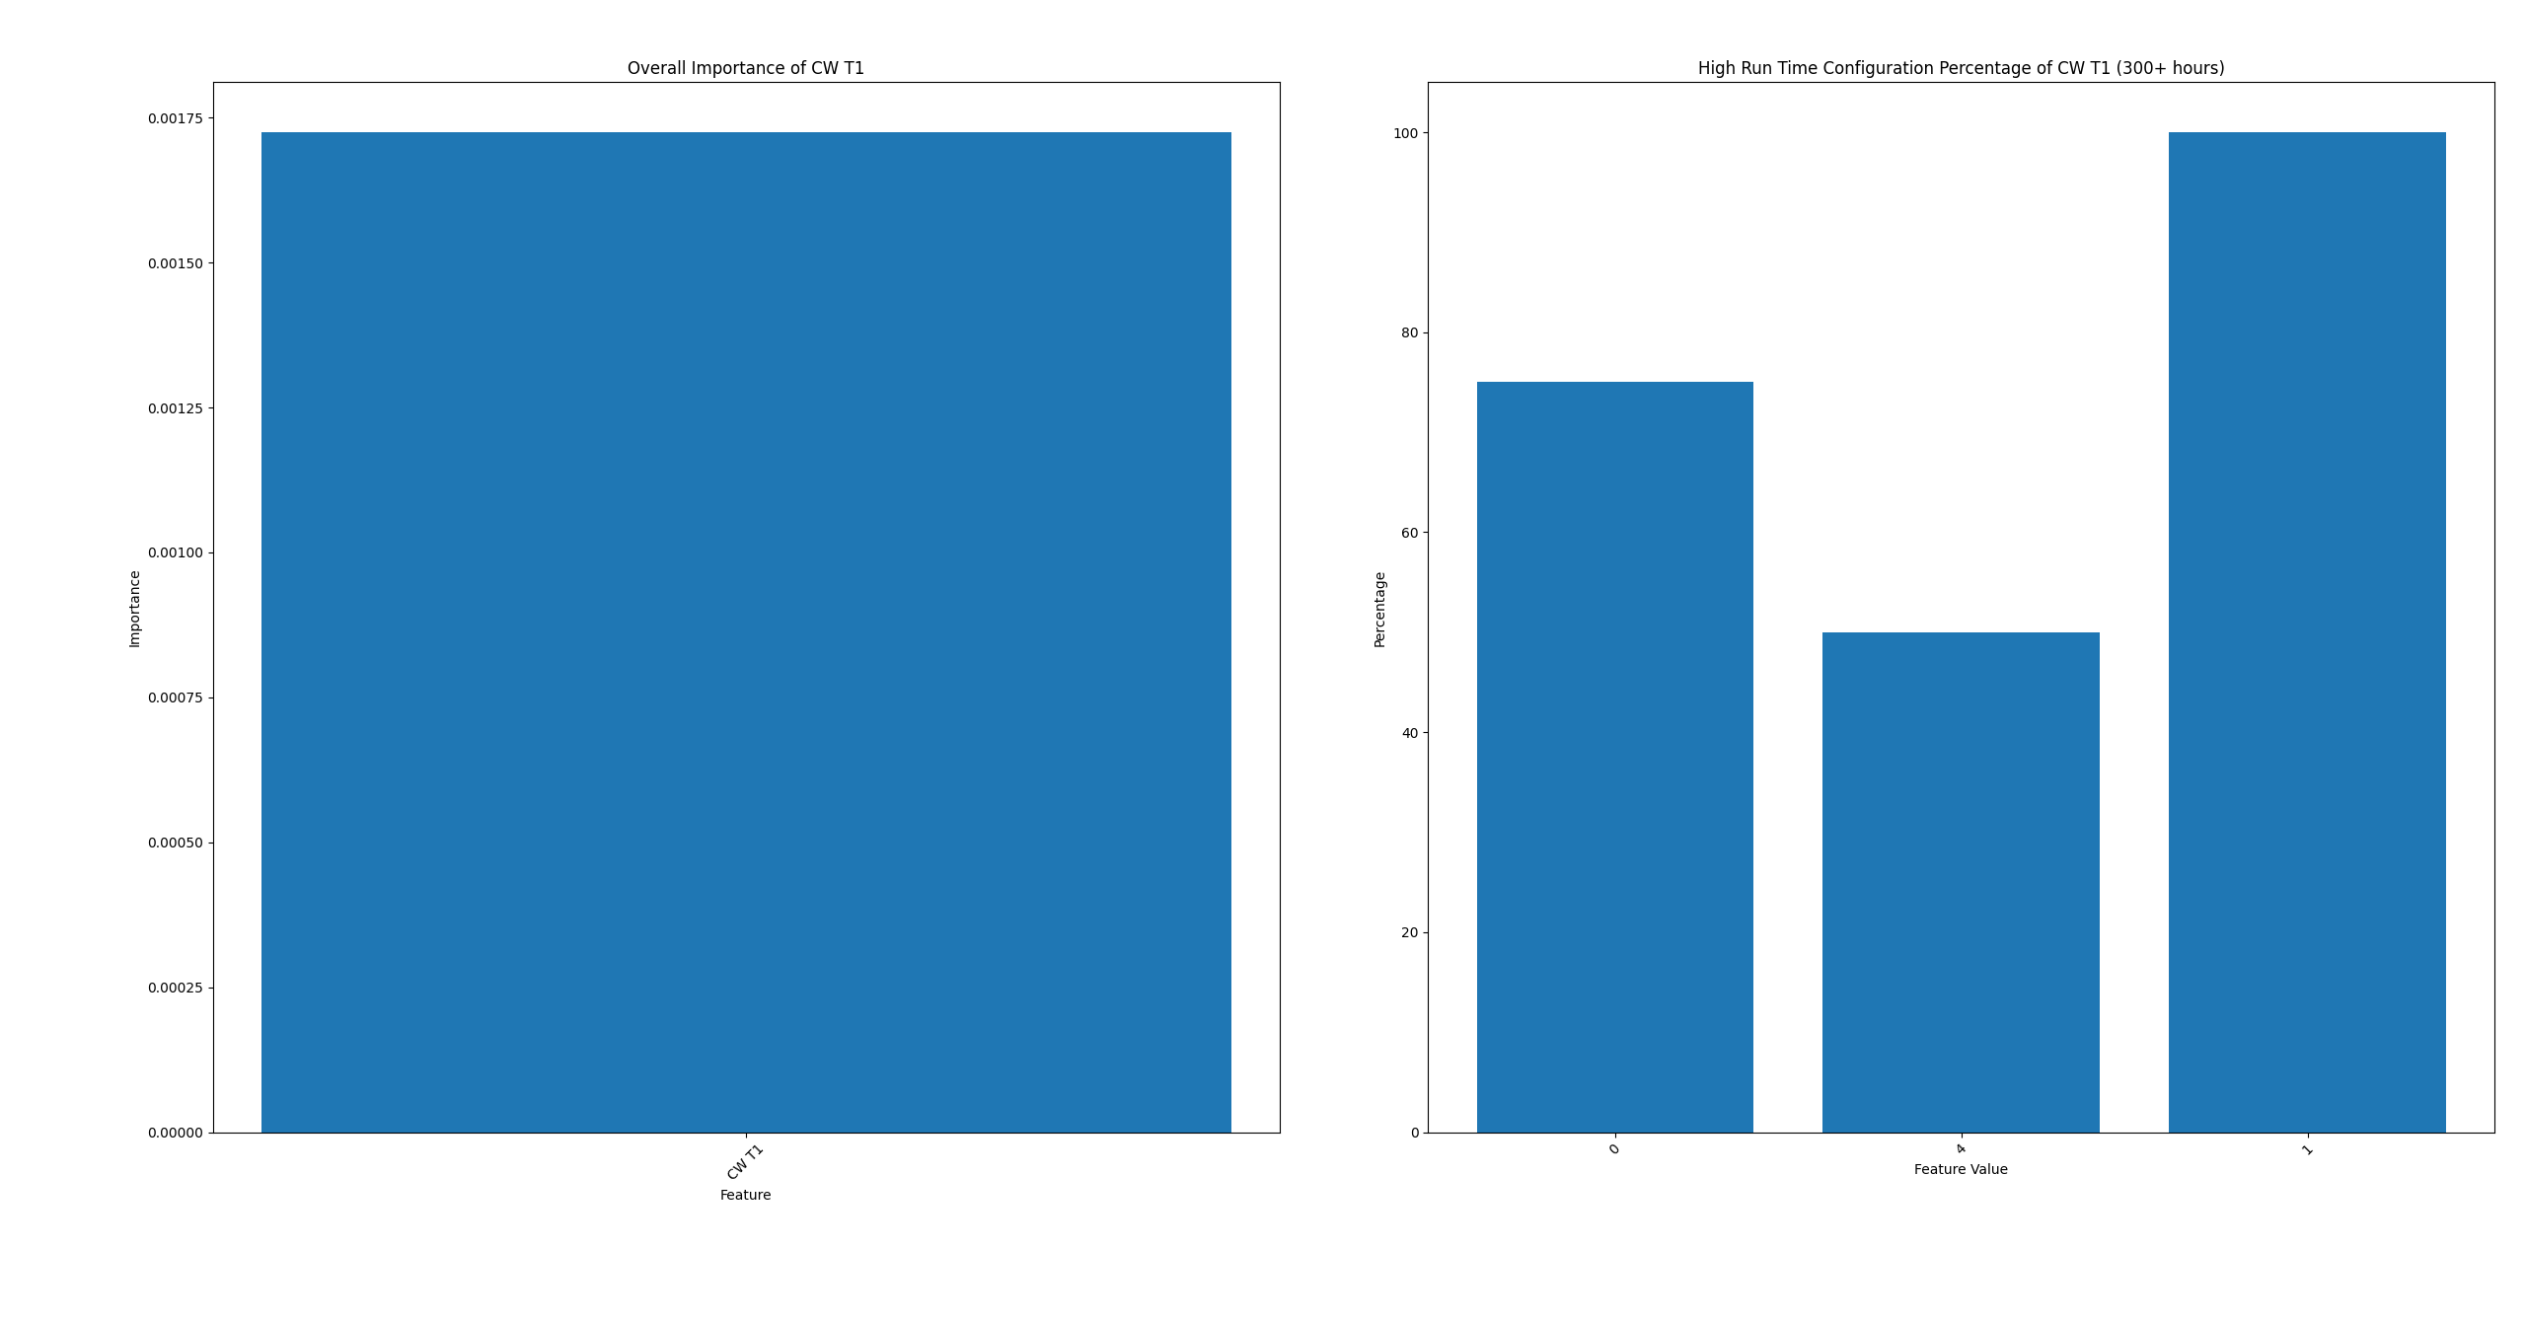
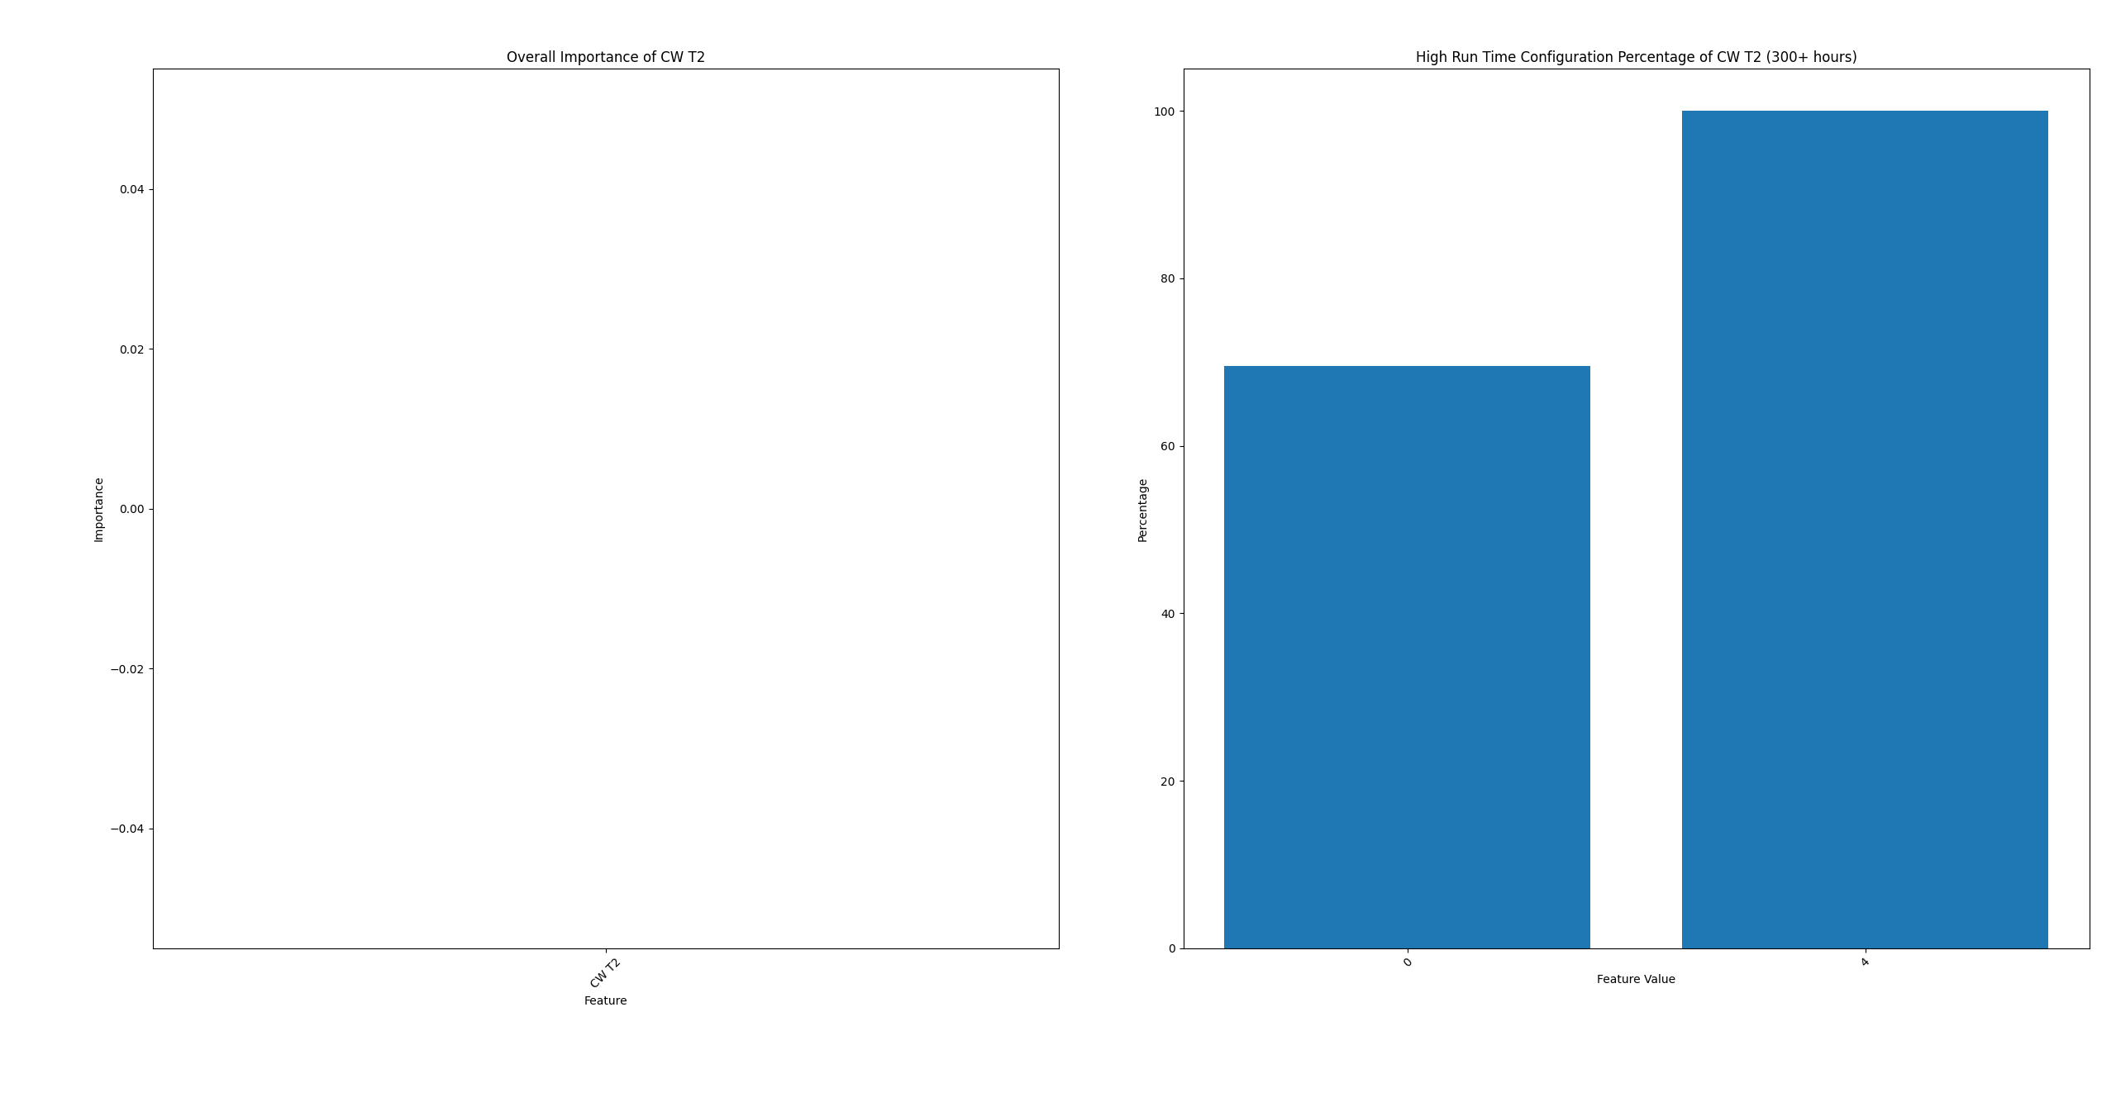
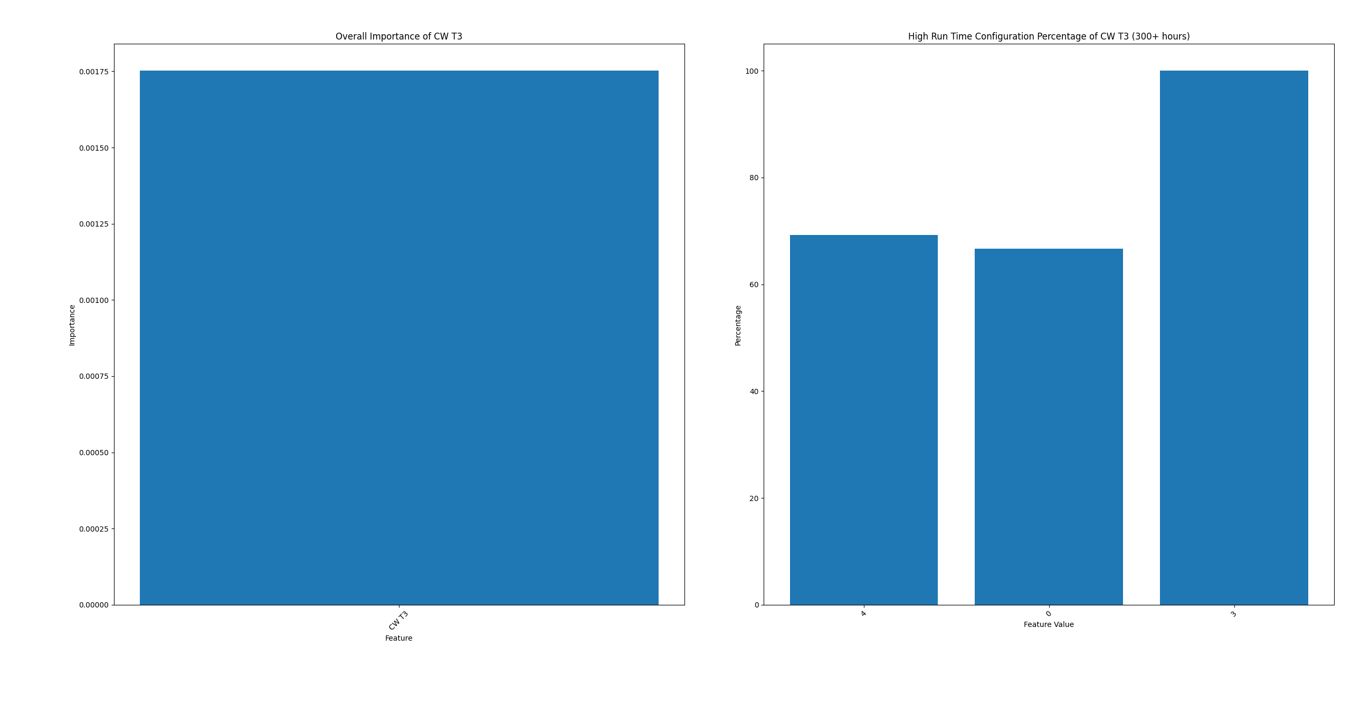
Results for CW Hinge

Slide 15

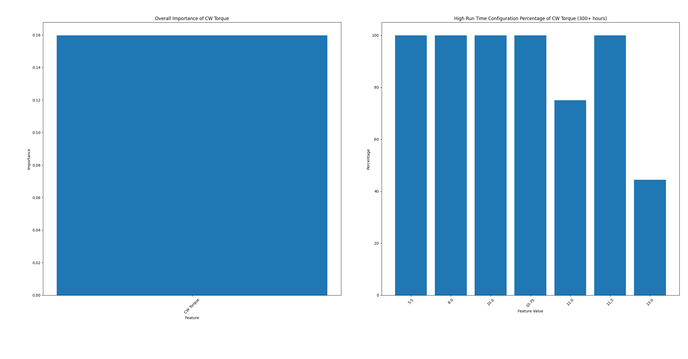
Results for CW Hinge

Slide 16
Results for CW Hinge

